Slide 1
Chapter 3
Cryptography & Public Key Infrastructure

Slide 2
Cryptology
Cryptography
The area of study containing the principles and methods of transforming an intelligible message into one that is unintelligible, and then retransforming that message back to its original form.
Cryptanalysis(Hacking)
Cryptanalysis is art and science of decoding non readable data without knowing techniques of encoding. OR
It is the process of attacking an encryption system is to recover the key in use.
Cryptology
Both Cryptography and Cryptanalysis Known as Cryptology

Slide 3
Symmetric Key Encryption
Symmetric encryption also referred to as conventional encryption or single-key encryption which use one key for both encryption and decryption.
A symmetric encryption system has the following components:
• Plaintext:
This is the original intelligible message or data that is fed into the algorithm as input.
Encryption algorithm:
The encryption algorithm performs various substitutions and transformations on plaintext, It takes in plaintext and key and gives the cipher text.
Secret key:
The secret key is also input to the encryption algorithm. The key is a value independent of the plaintext and of the algorithm.

Slide 4
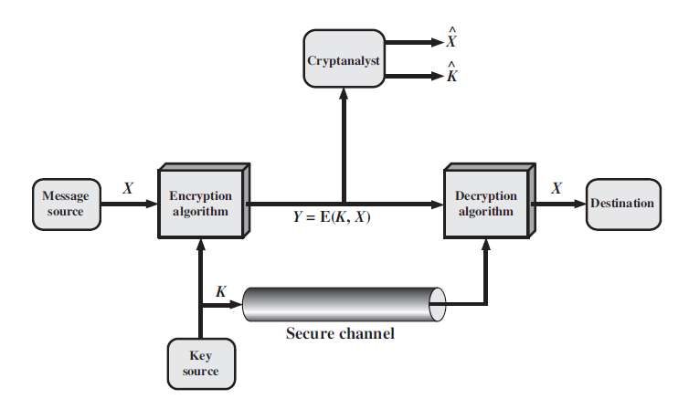
Cipher text:
This is the scrambled message produced as output. It depends on the plaintext and the secret key.
Decryption algorithm:
This is essentially the encryption algorithm run in reverse. It takes the cipher text and the secret key and produces the original Plaintext.

Slide 5
Two basic requirements of encryption are:
1) Encryption algorithm should be strong.
2) The key shared by the sender and the receiver should be secret.
Let the plaintext be X = [X1, X2,…, XM], key be K = [K1, K2,…, KJ] and the cipher text produced be Y = [Y1, Y2,…, YN],Then, we can write
Y = E(K, X)
Here E represents the encryption algorithm and is a function of plaintext X and key K.
The receiver at the other ends decrypts the cipher text using the key.
X=D(K,Y)
Here D represents the decryption algorithm and it inverts the transformations of encryption algorithm.
It is assumed that the opponent knows the encryption (E) and decryption (D) algorithms.

Slide 6
Asymmetric Key Encryption
Asymmetric encryption also referred to as public key encryption which uses two keys one is public key that is known by all and other is private key.
A symmetric encryption system has the following components:
• Plaintext:
This is the original intelligible message or data that is fed into the algorithm as input.
Encryption algorithm:
The encryption algorithm performs various substitutions and transformations on plaintext, It takes in plaintext and key and gives the cipher text.
Public and Private Key:
This is a pair of keys that have been selected so that if one is used for encryption, the other is used for decryption.

Slide 7
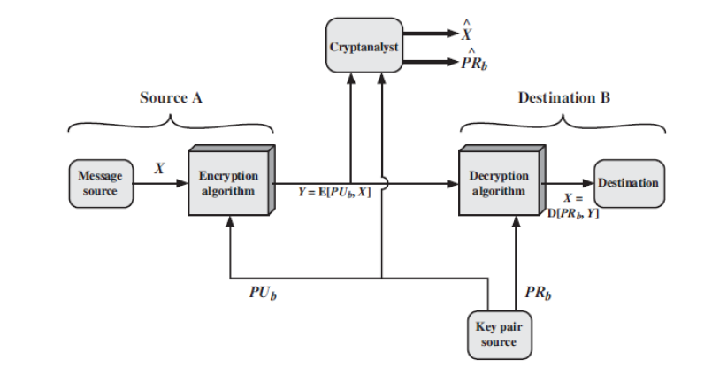
Cipher text:
This is the scrambled message produced as output. It depends on the plaintext and the key.
Decryption algorithm:
This is essentially the encryption algorithm run in reverse. It takes the cipher text and the key and produces the original Plaintext.

Slide 8
THE ESSENTIAL STEPS ARE THE FOLLOWING.
Each user generates a pair of keys to be used for the encryption and decryption of messages.
Each user places one of the two keys in a public register or other accessible file, This is the public key. The other key is kept private.
If A wishes to send a confidential message to B, A encrypts the message using B’s public key.
When B receives the message, it decrypts it using the private key. No other recipient can decrypt the message because only B knows B’s private key.
As long as a user’s private key remains protected and secret, incoming communication is secure.

Slide 9
Suppose there is some source A that produces a message in plaintext,
X = [X1, X2, . . . ,XM] and sends it to B.
B generates a related pair of keys: a public key, PUb, and a private key, PRb. PUb is publicly available and therefore accessible by A.
With the message X and the encryption key PUb as input, A forms the cipher text Y = [Y1, Y2, . . . , YN]:
Y = E(PUb, X)
The intended receiver, having the matching private key, is able to decrypt the message:
X = D(PRb, Y)

Slide 10
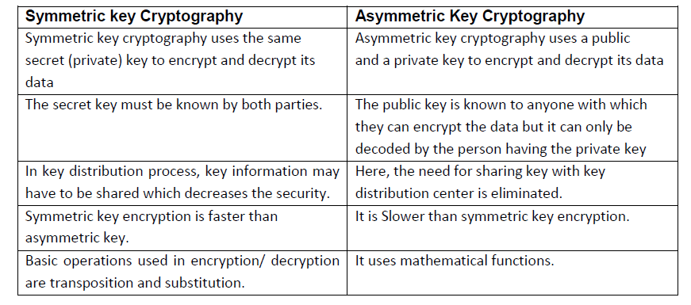

Slide 11
Substitution Technique (Encryption Algorithm)
Substitution Technique:
A substitution technique is one in which the letters of plaintext are replaced by other letters or by numbers or symbols.
Caesar Cipher ( Shift Cipher) (Additive Cipher) (Monoalphabetic Cipher)
Playfair Cipher
Hill Cipher
Vigenere Cipher (Polyalphabetic Cipher)
Vernam Cipher
One Time Pad Cipher (Vermin Cipher)

Slide 12
Caesar Cipher
In this cipher, Each letter in the plaintext is replaced by a letter some fixed number position (Key) down the alphabet.
For Example with shift 3 A would be replaced by D.
The alphabet is wrapped around so that Z follows A.
Example:
Plaintext: MEET ME AFTER THE PARTY
Ciphertext: PHHW PH DIWHU WKH SDUWB
Here, the key is 3. If different key is used, different substitution will be obtained.
Mathematically, starting from a=0, b=1 and so on, Caesar cipher can be written as:
E(p) = (p + k) mod (26)
D(C) = (C – k) mod (26)
This cipher can be broken:
1) If we know one plaintext-cipher text pair since the difference will be same.
2) There are only 26 possible keys.

Slide 13
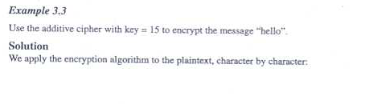


Slide 14
Brute force example
Eve has intercepted the cipher text “UVACLYFZLJBYL”. Show how she can use a brute-force attack to break the cipher.

Slide 15
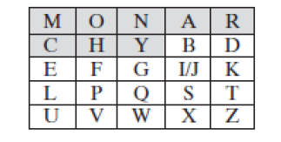
Playfair Cipher
invented in 1854 by Charles Wheatstone, but was named after Lord Playfair who promoted the use of the cipher.
In this cipher multiple (2) letters (digraph) are encrypted at a time.
This technique uses a 5 X 5 matrix which is also called key matrix, Here is an example.
Here the keyword is MONARCHY, the matrix is filled up by the letters of the key as shown in figure; and then fill up the remaining box by remaining letters.

Slide 16
The plaintext is encrypted two letters at a time:
1) Break the plaintext into pairs of two consecutive letters.
2) If a pair is a repeated letter, insert a filler like ‘X‘in the plaintext, eg. "balloon" is treated as "ba lx lo on“
3) If in the last there is only one letter then insert X after it to make a pair.
4) If both letters fall in the same row of the key matrix, replace each with the letter to its right (wrapping back to start from end), eg. “AR" encrypts as "RM"
5) If both letters fall in the same column, replace each with the letter below it (again wrapping to top from bottom), eg. “MU" encrypts to "CM“
6) Otherwise each letter is replaced by the one in its row in the column of the other letter of the pair, eg. “HS" encrypts to "BP", and “EA" to "IM" or "JM" (as desired)
If the plain text is YAGNIK then Cipher text is BNQYKE.
If there is pair of XX then pad it Y. Became XYX

Slide 17
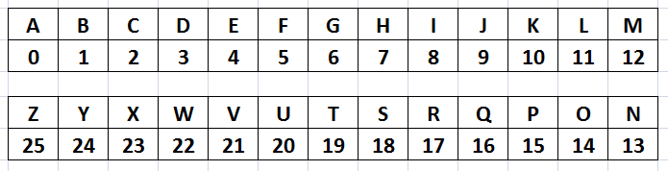
Hill Cipher
Another interesting multi letter cipher is the Hill cipher, developed by the mathematician Lester Hill in 1929.
Code Matrix is given below:

Slide 18
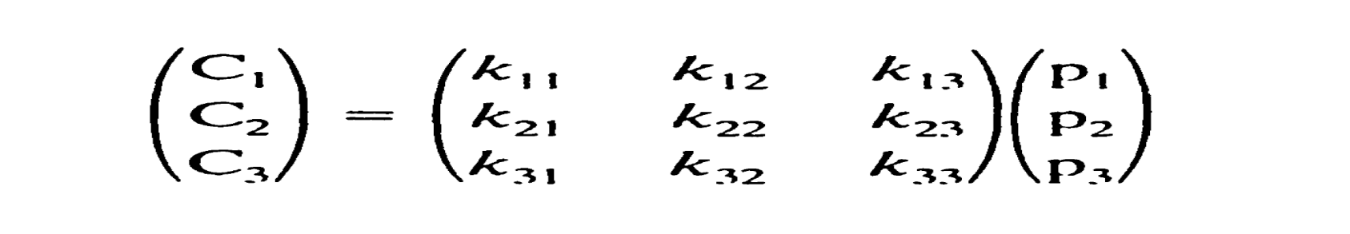
Hill Cipher
This cipher is based on linear algebra, Each letter is represented by numbers from 0 to 25 and calculations are done on modulo 26.
This encryption algorithm takes m successive plaintext letters and substitutes them with m cipher text letters.
The substitution is determined by m linear equations. For m = 3, the system can be described as:
c1 = (k11p1 + k12p2 + k13p3)mod 26
c2 = (k21p1 + k22p2 + k23p3)mod 26
c3 = (k31p1 + k32p2 + k33p3)mod 26
This can also be expressed in terms of row vectors and matrices, where C and P are row vectors of length 3 representing the plaintext and cipher text, and K is a 3 X 3 matrix representing the encryption key.

Slide 19
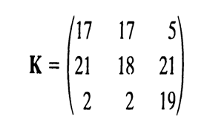
For example: If the Plain text is PAYMOREMONEY and if the key is given below ;
The first three letters of PT is in vector form is (15 0 24) then (15 0 24)K mod 26 is (375 819 486)mod 26 is (11 13 18) = LNS
Do the same for all then Cipher text is LNSHDLEWMTRW.
If you want to decryption then Do the Reverse of the encryption process.
Encryption and decryption can be given by the following formula,
Encryption: C=PK mod 26
Decryption: P=CK⁻¹ mod 26
Although the Hill cipher is strong against a cipher text-only attack, it is easily broken with a known plaintext attack.

Slide 20
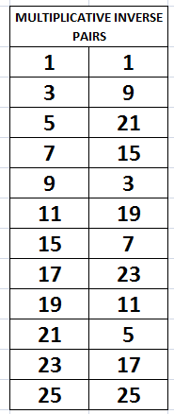

Slide 21
Polyalphabetic cipher
This is a type of polyalphabetic substitution cipher (includes multiple substitutions depending on the key).
In this type of cipher, the key determines which particular substitution is to be used.
To encrypt a message, a key is needed that is as long as the message. Usually, the key is a repeating keyword.
For Example if the PT is ATTACKATDAWN and key is LEMON, but here the key is no long enough compare with PT so we repeat the key as depicted below;
PT = ATTACKATDAWN
KEY = LEMONLEMONLE
For example, the first letter of the plaintext A is paired with L the first letter of the key, So use row L and column A of the Vigenère square, namely L. Similarly, The rest of the plaintext is enciphered in a similar fashion.
CT = LXFOPVEFRNHR

Slide 22
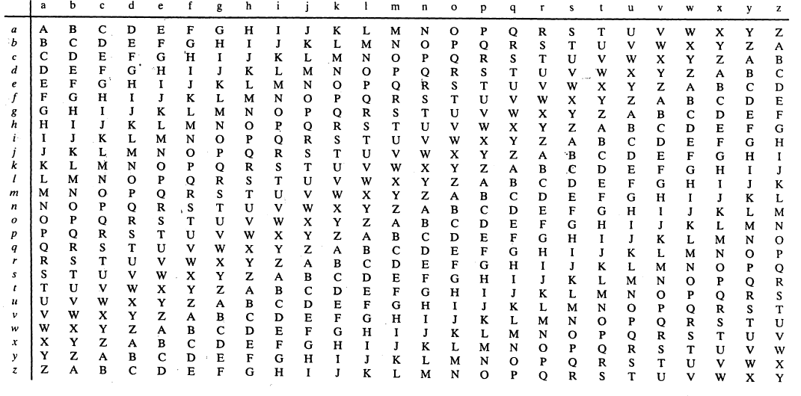

Slide 23
Vernam Cipher
This system works on binary data (bits) rather than letters, The technique can be expressed as follows:
ci = pi⊕ki
where
pi = ith binary digit of plaintext
ci = ith binary digit of ciphertext
ki = ith binary digit of key
⊕= XOR operation
Thus, the ciphertext is generated by performing the bitwise XOR of the plaintext and the key.
Decryption simply involves the same bitwise operation:
pi = ci⊕ki
Here the conversion from alphabets to binary is done with the reference of their ASCII Code. ( For A=65,B=66 and So on….,For a=97,b=98 and so on)

Slide 24
If PT = ABC and KEY = DEF then Encryption Process are depicted below,
PT = 1000001 1000010 1000011
KEY = 1000100 1000101 1000110
CT = PT ⊕ KEY in Binary = 0000101 0000111 0000101
If CT = ABC and KEY = DEF then Decryption Process are depicted below,
CT = 1000001 1000010 1000011
KEY = 1000100 1000101 1000110
PT = CT ⊕ KEY in Binary = 0000101 0000111 0000101

Slide 25
One Time Pad Cipher
In this scheme, a random key that is as long as the message is used, The key is used to encrypt and decrypt a single message, and then is discarded, Each new message requires a new key of the same length as the new message.
This scheme is unbreakable.
It produces random output that bears no statistical relationship to the plaintext, Because the ciphertext contains no information whatsoever about the plaintext, there is simply no way to break the code.
For any plaintext of equal length to the ciphertext, there is a key that produces that plaintext.
Therefore, if you did an exhaustive search of all possible keys, you would end up with many legible plaintexts, with no way of knowing which was the intended plaintext.
Therefore, the code is unbreakable.

Slide 26
The security of the one-time pad is entirely due to the randomness of the key.
The one-time pad offers complete security but, in practice, has two fundamental difficulties:
1. There is the practical problem of making large quantities of random keys, Any heavily used system might require millions of random characters on a regular basis. Supplying truly random characters in this volume is a significant task.
2. Another problem is that of key distribution and protection. For every message to be sent, a key of equal length is needed by both sender and receiver.
The one-time pad is the only cryptosystem that exhibits perfect secrecy.

Slide 27
Transposition Techniques (Encryption Algorithm)
Transposition Technique:
A Transposition technique is one in which perform some sort of permutation on the plain text letters.
Rail Fence.

Slide 28
Rail Fence
Encryption involves writing plaintext letters diagonally over a number of rows, then read off cipher row by row.
For example, the text “meet me after the toga party” with a rail fence of depth 2, we write the following:
m e m a t r h t g p r y
e t e f e t e o a a t
The Encrypted Message: MEMATRHTGPRYETEFETEOAAT
This scheme is very easy to cryptanalyze as no key is involved.

Slide 29
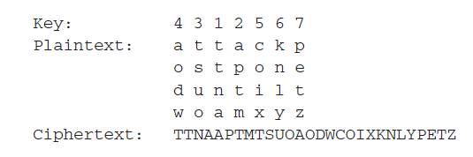
Rail Fence(column cipher)
A more complex scheme is to write the message in a rectangle, row by row, and read the message off, column by column, but permute the order of the columns. The order of the columns then becomes the key to the algorithm.
For example,

Slide 30
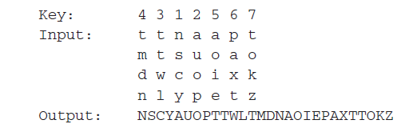
The transposition cipher can be made significantly more secure by performing more than one stage of transposition. The result is a more complex permutation that is not easily reconstructed. Thus, if the foregoing message is re encrypted using the same algorithm,

Slide 31
Steganography
Steganography is a technique that facilitates hiding of a message that is to be kept secret inside other message.
OR
Steganography means hiding information in other information, Anyone else viewing this message will fail to know because it contains hidden/encrypted data.
Historically the sender used methods such as,
Invisible Ink
Tiny Pin Punctures on Specific Characters
Pencil Marks on Characters etc
There are basically four types.
Encoding Secret Messages in Text
Encoding Secret Messages in Audio
Encoding Secret Messages in Images
Encoding Secret Messages in videos

Slide 32
Encoding Secret Messages in Text (Text Steganography)
It is a technique that facilitates hiding of a message that is to be kept secret inside other text message.
It can be accomplished through various techniques:
Line-shift encoding
In this type of coding, Text lines is shifted up/down
Word-shift encoding
In this type of encoding, Word is shifted left to right or vice versa.
Feature encoding
In this type of encoding, minor changes occurs in shapes of characters.

Slide 33
Encoding Secret Messages in Audio
It is a technique that facilitates hiding of a message that is to be kept secret inside other Audio message or music files.
The different methods are:
Low-bit encoding
In this type of coding, data was stored in the least significant bit of images, binary data can be stored in the least significant bit of audio files
Phase coding
The phase coding method works by substituting the phase of an initial audio segment with a reference phase that represents the data.
Spread spectrum
When using a spread spectrum technique, however, the encoded data is spread across as much of the frequency spectrum as possible.

Slide 34
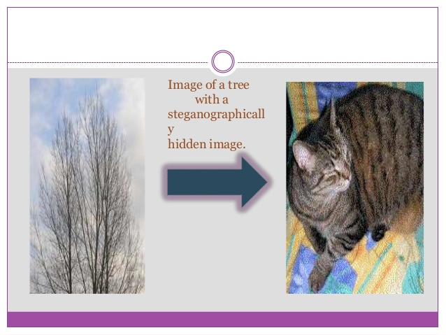
3. Encoding Secret Messages in Images
It is a technique that facilitates hiding of a message that is to be kept secret inside other Image message.
Images are composed of dots called PIXELS, The basic example is depicted below,
4. Encoding Secret Messages in Videos
It is a technique that facilitates hiding of a message that is to be kept secret inside other video message.

Slide 35
ADVANTAGES
It is used in the way of hiding not the information but the password to reach that information.
Difficult to detect.
Only receiver can detect.
Can be applied differently in digital image, audio and video file.
It can be done faster with the large number of software's.
DISADVANTAGES
Huge number of data, huge file size, so someone can suspect about it.
If this technique is gone in the wrong hands like hackers, terrorist, criminals then this can be very much dangerous for all.

Slide 36
Hashing & Hash Function
Hashing is technique of obtain hash function which provides digital signature to the content.
Hash Function is one of the techniques that is used for Message authentication and maps a message of any length into a fixed-length hash value, which serves as the authenticator.
The various application of Hash Function are depicted below,
Digital Signature
File Integrity Verification
Password Hashing
Key Derivation
Root Kit Detection

Slide 37
Secure Hash Algorithm-1 (SHA-1)
This hashing algorithm takes as input a message of maximum length of less than 2^64 bits and produces a 160-bit message digest (MD), The input is processed in 512-bit blocks.
The Algorithm Step are listed below:
Append Padding bits and length
Pad the message with a single one followed by zeroes until the final block has 448 bits That means the message is padded so that its length is congruent to 448 (modulo 512) (length = 448 mod 512).
A block of 64 bits is appended to the message which contains the length of the original message in binary.
The message is now an integer multiple of 512 bits in length.
In the figure below, expanded message is represented as the sequence of 512-bit blocks M1, M2,..., MN and the total length of the expanded message is N x 512 bits.

Slide 38
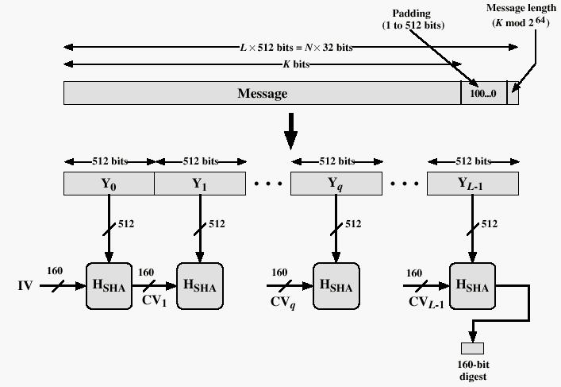

Slide 39
Initialize variables (hash blocks)
Initialize the 5 hash blocks (h0,h1,h2,h3,h4), ml = message length in bits & Also initialize A 160-bit buffer is used to hold intermediate and final results of the hash function, The buffer can be represented as eight 32-bit registers (a, b, c, d, e).
Process Message in 512-bit (16-word) blocks.
break message into 512-bit block, Allocate an 80 word array for the message schedule.
for each block
break block into sixteen 32-bit words w[i], 0 ≤ i ≤ 15
Extend the sixteen 32-bit words into Eighty 32-bit words
for i from 16 to 79
w[i] = w[i-3] xor w[i-8] xor w[i-14] xor w[i-16]) left rotate 1
Initialize hash value for this block
a = h0
b = h1
c = h2
d = h3
e = h4

Slide 40
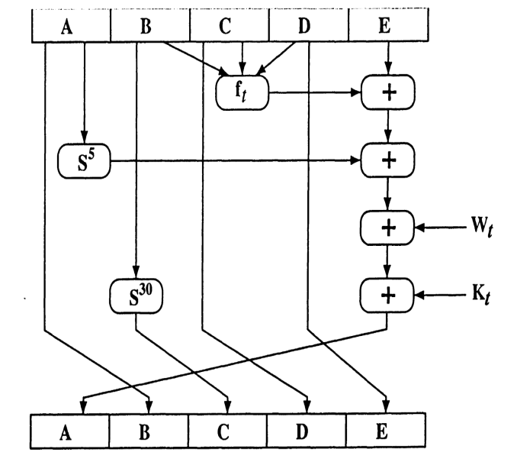
Main Loop:
for i from 0 to 79
if 0 ≤ i ≤ 19
then f = (b and c) or ((not b) and d)
k = 0x5A827999
else if 20 ≤ i ≤ 39
f = b xor c xor d
k = 0x6ED9EBA1
else if 40 ≤ i ≤ 59
f = (b and c) or (b and d) or (c and d)
k = 0x8F1BBCDC
else if 60 ≤ i ≤ 79
f = b xor c xor d
k = 0xCA62C1D6
a = (a leftrotate 5) + f + e + k + w[i]
b = a
c = b leftrotate 30
d = c
e = d

Slide 41
Add a,b,c,d and e to the hash output
h0 = h0 + a
h1 = h1 + b
h2 = h2 + c
h3 = h3 + d
h4 = h4 + e
Produce the final hash value as a 160 bit number
hh = (h0 left shift 128) or (h1 left shift 96) or (h2 left shift 64) or (h3 left shift 32) or h4

Slide 42
Digital Signature
It is an electronic signature that can be used to authenticate the identity of a sender of a message or the signer of a document.
It also ensure that the original content of a message or document that has been sent is unchanged.
The use of digital signature usually involves two processes:
Digital Signature Creation (Performed by the signer/sender).
Here The Signature is created with the help of Message Digest and Private Key.
Message Digest is Nothing but the Valid output of hash function, here Hash Function is one of the techniques that is used for Message authentication and maps a message of any length into a fixed-length hash value, which serves as the authenticator.
2. Digital Signature Verification (Performed by the receiver).
Here The Signature is verified with the help of Message Digest and Public Key, and based on that the decision (Valid or invalid) is carried out.
This all Process is depicted below.

Slide 43
Message/Data
Message/Data
Hash Function
Hash Function
Message Digest
Message Digest
Signature Generation
Signature verification
Signature
Valid or Invalid
Private key
Public key

Slide 44
Key Escrow
Key Escrow is a cryptographic key exchange process in which a key is held in a escrow (vault) or stored by the third party which provide a backup source for cryptographic keys.
This system is some what risky because a third party is involved here.
The purpose of it is to serve as a backup if the parties with access to the cryptographic key loss the data.
Example :
Company A supplies software that Company B sells embedded in its hardware.
Company B, worried that Company A may go out of business, So B requests that Company A place the source code for the software in Escrow.
So as a authorized user of a software source code, company B can access that source code even if company A goes out of Business.

Slide 45
Public Key Infrastructure
A public key infrastructure (PKI) is a set of hardware, software, people, policies, or procedures needed to create, manage, distribute, and use digital certificates. (digital certificate are used to verify that a particular public key belongs to a certain entity).
PKI is generally used in VPN, Secure Email, and Web Security
Digital Certificate is a data with digital signature from one trusted Certification Authority (CA), This data contains:
Who owns this certificate
Who signed this certificate
The expired date
User name & email address
Version
Subject Name etc..

Slide 46
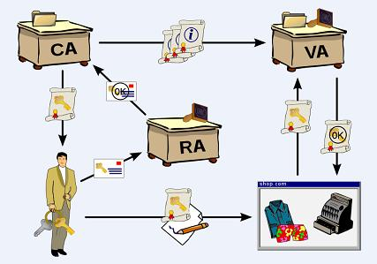
The figure is depicted below,

Slide 47
A PKI consists of:
1. Certification Authority (CA)
CA has the authority to issue digital certificates to individuals and organizations, which want to use those certificates in asymmetric key cryptographic applications.
2. Registration Authority(RA)
A registration authority (RA) is an authority in a network that verifies user requests for a digital certificate and tells the certificate authority (CA) to issue it.
3. Verification Authority (VA)
A secure location which store and index keys which is used to matching that key whenever it is required.
4. Certificate Policy

Slide 48
Steps for Obtaining Digital Certificate
1. Application Phase
In the application phase, the applicant will access the CA website to select customer type and class of certificate needed.
After that, the applicant will be taken to online registration form.
After verification of mandatory fields, the applicant confirm the given details. The applicant will also print the displayed form to hand sign and send it across to the CA.

Slide 49
2. Authentication Phase
In authentication phase, RA verifies the information provide in the online application and identification form.
Upon approval of application, RA will send you an email on the email address provided in the application form with a link for email id verification.
3. Retrieval Phase
After email verification, receipt of documents and payment of fees, Reference Number will be sent through email whereas Authorization Code will be sent through registered A.D. on the postal address provided in the application form, Once you have received your retrieval email, you will be able to access your Digital Certificate.

Slide 50
Centralized &Decentralized Infrastructure
The key pairs used in a PKI are generated using the two basic methods that are depicted below.
In a Centralized Infrastructure, The key are generated and stored on a central server and are transmitted to the individual systems as needed.
ADVANTAGES : If a company uses a resource intensive algorithm to generate the public/private key pair and if the key sizes that are needed are large and resource intensive ,then the individual computers may not have the necessary processing power to produce the key on that case this infrastructure is useful.
DISADVANTAGES : Here all keys are stored in one place which is prime target for an attacker.
In a Decentralized Infrastructure, software's on individual computers generates and stores cryptographic keys local to the systems themselves.

Slide 51
Private Key Protection
The private key needs to stay private for that purpose the following list of the characteristics and requirements of proper private key use are depicted below
The life time of the key should correspond with how often it is used and the sensitivity of the data it is protecting
The key should be changed at the end of its life time
The key should be never be exposed in clear text
The key should be stored securely
Authentication should be required before the key can be used
The key should be transported securely
Software implementations that store and use the key should be evaluated to ensure they provide the necessary level of protection.

Slide 52
Trust Model
A trust Model is collection of rules that informs application on how to decide the authenticity of a Digital Certificate Or we can say that distributed system of CA s.
Three types of Trust Model
Hierarchical Model
Peer to Peer Model(Bridge Model)
Hybrid Model

Slide 53
Hierarchical Trust Model
It is a basic hierarchical structure that contains a root CAs, Intermediate CAs, Leaf CAs and end entities.
This arrangement is depicted on figure,
The root CA is the ultimate trust anchor for all other entities in the infrastructure and it generates certificates for the intermediate CA s , which in turn generates the certificates for the leaf CA s and the leaf CA s generates certificates for the end entities ( users , network devices , and applications)
In a hierarchical trust model a root CA at the top provides all the information , and the intermediate CA s function to transfer trust between different CA s.
This arrangement allows a high level of control at all levels of the hierarchical tree.

Slide 54
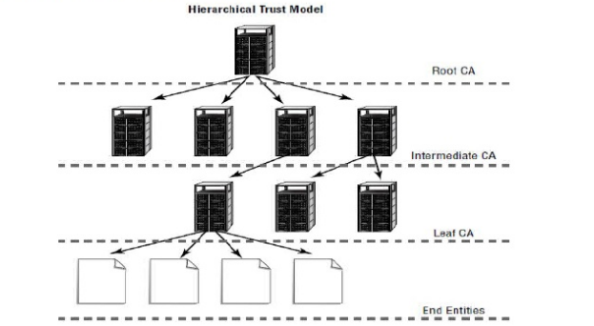

Slide 55
Bridge Model (Peer to Peer Model)
In a bridge trust model, a peer-to-peer relationship exists between the root CAs, The root CAs can communicate with each other, allowing cross certification which allows a certification process to be established between organizations or departments.
Each intermediate CA trusts only the CAs above and below it.
This model may be useful if you’re dealing with a large, geographically dispersed organization or you have two organizations that are working together.
This arrangement is depicted on figure,
Advantages:
Additional flexibility between organizations.

Slide 56
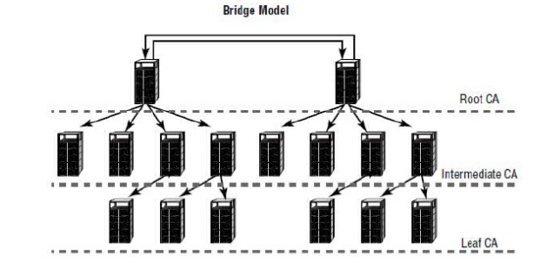

Slide 57
Hybrid Model
A Hybrid Trust Model can use the capabilities of any or all of the trust model, hence you can be extremely flexible when you build a hybrid trust structure.
Notice that in this structure, the single intermediate CA server on the right side of the illustration is the only server that is known by the CA below it.
The subordinates of the middle-left CA are linked to the two CAs on its sides.
These two CAs don’t know about the other CAs, because they are linked only to the CA that provides them a connection.
The two intermediate servers in the middle of the illustration and their subordinates trust each other; they don’t trust others that aren’t in the link
In our example, a user could accidentally be assigned to one of the CAs in the middle circle, As a member of that circle, the user could access certificate information that should be available only from their root CA.

Slide 58
